Slide 1
A new R package statTarget Hemi Luan

Slide 2
statTarget
A graphical user interface, easy to use tool provide quality control based signal correction, integration of metabolomic data from multiple batches, and the comprehensive statistic analysis for non-targeted and targeted approaches.

Slide 3
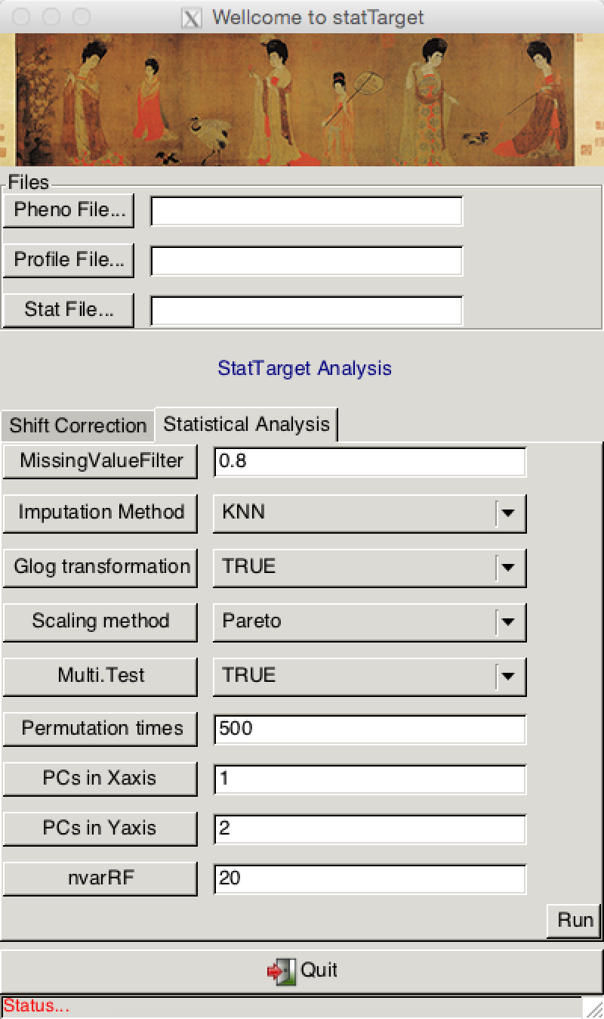
Main - GUI
Component 1 – Shift Correction
statTarget
A graphical user interface, easy to use tool provide quality control based signal correction, integration of metabolomic data from multiple batches, and the comprehensive statistic analysis for non-targeted and targeted approaches.
Component 2 Statistical Analysis

Slide 4
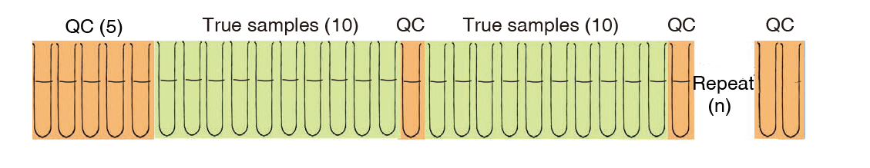
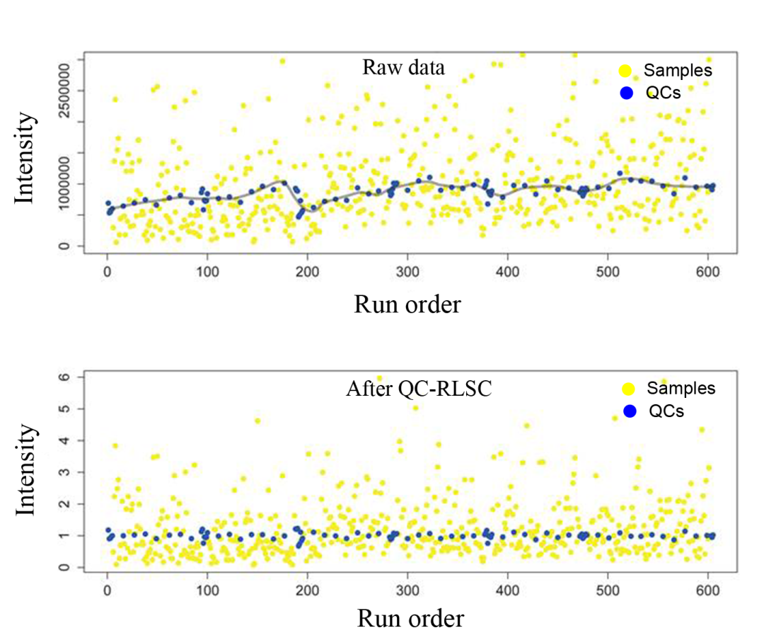
Function 1 --- Shift Correction
Quality control based signal correction (Cross validated LOESS)

Slide 5
Function 2--- statistical analysis
data descriptions
mean value
Data Preprocessing
80% rule
Multi and uni- variate analysis
PCA
PLSDA
OPLSDA
VIP
ROC
random forest
odd ratio
student t test
log transformation
normalization
median value
sum
quartile
standard derivatives
shapiro wilk normality test
mann whitney tests
Fold change

Slide 6
Data input for shift correction
Saved as .csv
Meta information (Pheno File)
sample | batch | class | order
batch01_QC01 | 1 | NA | 1
batch01_QC02 | 1 | NA | 2
batch01_QC03 | 1 | NA | 3
batch01_C05 | 1 | 1 | 4
batch01_S07 | 1 | 2 | 5
batch01_C10 | 1 | 1 | 6
batch01_QC04 | 1 | NA | 7
The title could be not changed
* The class or group should be ordinal number, e.g., 1,2,3,4,5…
Expression data (Profile File)
name | batch01_QC03 | batch01_QC01 | batch01_QC02 | batch01_C05
78.02055 | 14023 | 13071 | 15270 | 0
452.00345 | 22455 | 10737 | 27397 | 16898
138.96337 | 6635.4 | 8062.3 | 6294.6 | 6380.5
73.53838 | 26493 | 26141 | 25944 | 14949
385.12885 | 57625 | 56964 | 59045 | 78490
237.02815 | 105490 | 90166 | 92315 | 90442
222.02744 | 34676 | 34025 | 30253 | 30470
399.33298 | 42457 | 44250 | 41942 | 209710
394.23541 | 36120 | 29848 | 36707 | 14463
446.13947 | 7789.3 | 9748.6 | 8932.4 | 0

Slide 7
Data input for statistical analysis
Sample name Group Factor
Saved as .csv --Stat File
Metabolites ID
Order | Group | 1 | 2 | 3 | 4 | 5
21 | 1 | 0.0269394 | 0.212481308 | 0.421938647 | 0.072731082 | 0.476999498
71 | 1 | 0.004056653 | 0.104999071 | 0.014279731 | 0.024105957 | 0.167094773
50 | 1 | 0.004056653 | 0.570556469 | 0.171406702 | 0.02019163 | 0.061832702
14 | 2 | 0.014602305 | 4.650099858 | 0.022114445 | 0.007105695 | 0.156819962
74 | 1 | 0.045739012 | 0.36876884 | 0.019088228 | 0.006108264 | 0.278668387
9 | 2 | 0.008098186 | 0.235025541 | 0.182280343 | 0.025622084 | 0.046807751
32 | 1 | 0.019498917 | 0.683527006 | 0.035527196 | 0.014959372 | 0.430006029
20 | 2 | 0.004056653 | 0.060402839 | 0.015232417 | 0.007500019 | 0.149098523
168 | 1 | 0.015402529 | 1.036678761 | 0.155572884 | 0.022977097 | 0.152309431
28 | 2 | 0.036884932 | 6.041892945 | 0.103977726 | 0.017530557 | 0.299275534
62 | 2 | 0.031621389 | 6.028034401 | 0.352036582 | 0.086246923 | 0.935893131
Concentration

